Slide 1
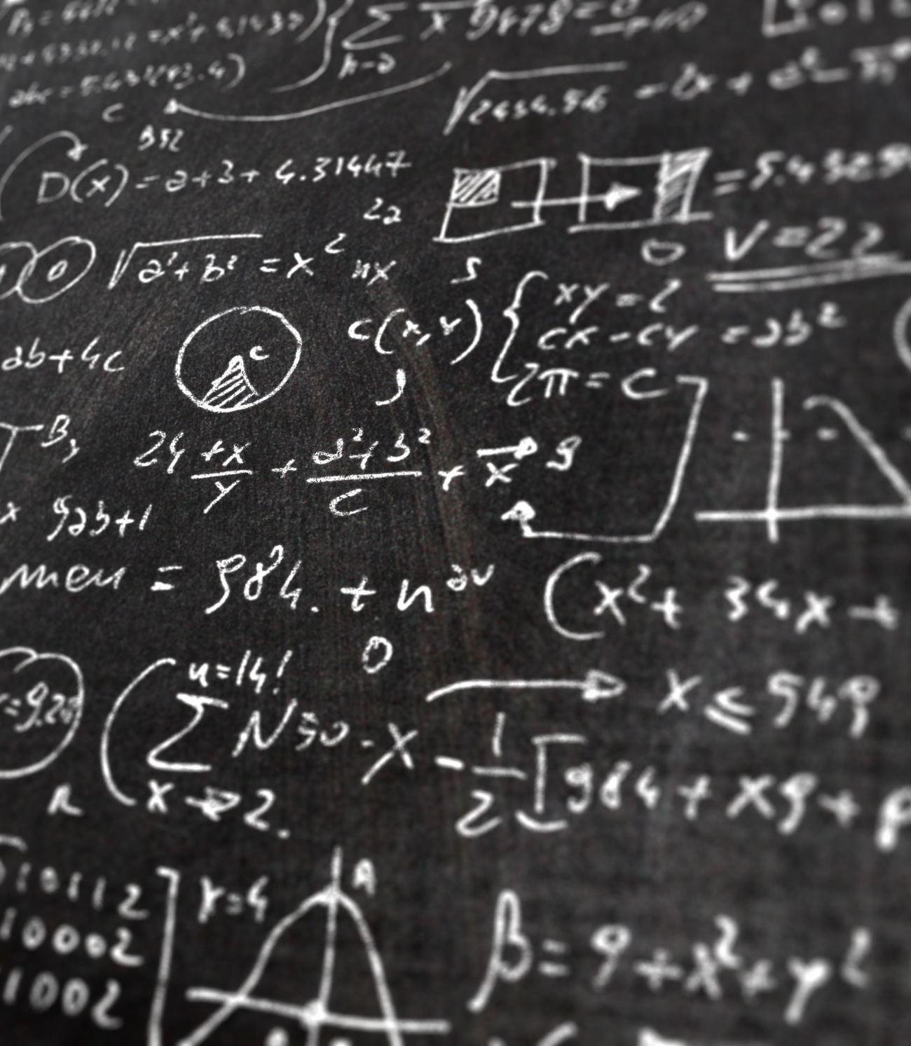
Data Types and Variables
Understanding Data Types in Programming
INTRO TO DATA SCIENCE
MOUSSA DOUMBIA, Ph.D.
8 Sep. 2023

Slide 2
Introduction
Overview of Data Types
Why Data Types are Important
Variables: Storing Different Types of Data

Slide 3
Integer
Definition: A data type representing whole numbers, both positive and negative.
Characteristics
Whole numbers without decimal points
Can be both positive and negative
Use Cases
Counting
Whole number arithmetic

Slide 4
Float
Definition: A data type representing real numbers, which are numbers with decimal points.
Characteristics
Contains decimal points
Can represent very large or very small numbers
Use Cases
Scientific calculations
Financial calculations

Slide 5
Boolean
Definition: A data type representing true or false values.
Characteristics
Can only be true or false
Use Cases
Conditional logic
Controlling program flow

Slide 6
String
Definition: A data type representing a sequence of characters.
Characteristics
Can contain letters, numbers, spaces, and symbols
Enclosed in quotes
Use Cases
Text representation
User input

Slide 7

Array
Definition: A data structure representing a collection of values.
Characteristics
Can store multiple values
The values can be of different data types
Use Cases
Storing collections of data
Sorting and searching operations

Slide 8

Tuple
Definition: Similar to an array but immutable, meaning its elements cannot be changed after creation.
Characteristics
Fixed size
Cannot be altered once created

Slide 9
List
Definition: A list in Python is a data structure used to store multiple items in a single variable. Lists are ordered, changeable, and allow duplicate members. Here's a deeper explanation and some examples:
Ordered: Lists store items in an ordered sequence, which means items have a defined order that will not change unless explicitly done by the programmer.

Slide 10
List
Changeable: Lists are mutable, allowing you to change, add, and remove items after the list is defined.
Allows Duplicate Members: In a list, the items do not need to be unique. The same item can appear more than once.
Creating a List:
Lists are created by placing the items (elements) you want to store in the list inside square brackets [], separated by commas.

Slide 11
List
Example my_list = [1, 2, 3, "Python", "is", "fun"]
Accessing Elements:
You can access elements in the list by referring to their index number. Index numbers start at 0 for the first element.
Example: my_list[0] # Output: 1
my_list[3] # Output: "Python"

Slide 12
Modifying a List
Lists are mutable, meaning you can change their elements.
Example:
my_list[1] = 200
# my_list is now [1, 200, 3, "Python", "is", "fun"]

Slide 13
Methods
Python lists have a variety of methods that allow you to manipulate the list, such as append() to add a new item, remove() to remove an item, and sort() to sort the items.
Example: my_list.append("!")
# my_list is now [1, 200, 3, "Python", "is", "fun", "!"]

Slide 14

Dictionary
Definition: A collection of key-value pairs, where each key is associated with a value.
Characteristics
Unordered
Contains key-value pairs
Use Cases
Storing and retrieving data efficiently
Structuring data in a meaningful way

Slide 15
Object
Definition: In object-oriented languages, this can represent an instance of a class, which can contain multiple types of data and methods.
Characteristics
Contains properties and methods
Can represent complex data structures
Use Cases
Creating complex data structures
Object-oriented programming

Slide 16
Variables in Python
Definition of Variables
Variables are named locations in memory used to store data that can be used and manipulated throughout a program
Hold different types of data values.
Characteristics of Variables in Python
Dynamically Typed: No need to declare the type of data a variable holds
Mutable: Can change value over the course of the program
Can have meaningful names to make the code more readable

Slide 17
Variable Naming Conventions
Rules:
Must start with a letter or an underscore
Can only contain letters, numbers, and underscores
Are case-sensitive
Examples:
Valid: my_variable, _myVariable, variable1
Invalid: 1variable, my-variable, my variable

Slide 18
Variable Assignments in Python
Using the assignment operator (=) to assign values to variables
Example: variable_name = value
Multiple Assignments
Assigning values to multiple variables at once
Example: x, y, z = 5, "Hello", True
Variable Reassignment
Changing the value of a variable
x = 5
x = 7

